Slide 1
Why is crypto so hard to get right?
Ron Bowes, Leviathan Security Group
Sharkfest 2013

Slide 2


About me
Ron Bowes
@iagox86
http://www.skullsecurity.org
ron.bowes@leviathansecurity.com
Security consultant for Leviathan Security Group
Founder/president of SkullSpace, Winnipeg’s hackerspace
Rockclimber
A great prairie past time!
Did I mention I'm from Winnipeg?

Slide 3
Quick agenda
History of crypto attacks
A bunch of examples, with proofs of concept
Key re-use
Hash length extension
Padding oracle
Some proposed solutions

Slide 4
Why am I doing this?
In my opinion, crypto is one of the most important technologies in the modern world, if implemented correctly
Crypto implementation is hard
I decided to teach myself attacks by writing tools
Before I knew it, I had enough to make an interesting talk!
A theme I'll repeat over and over: use cryptographic constructs for what they're designed for!

Slide 5
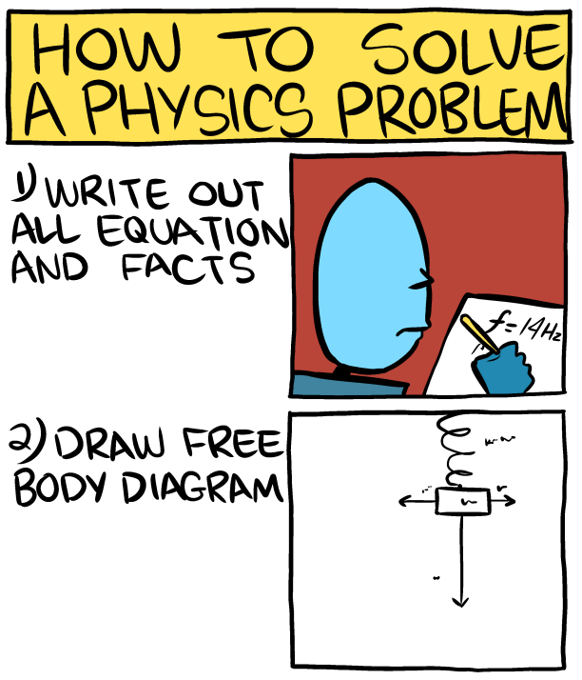
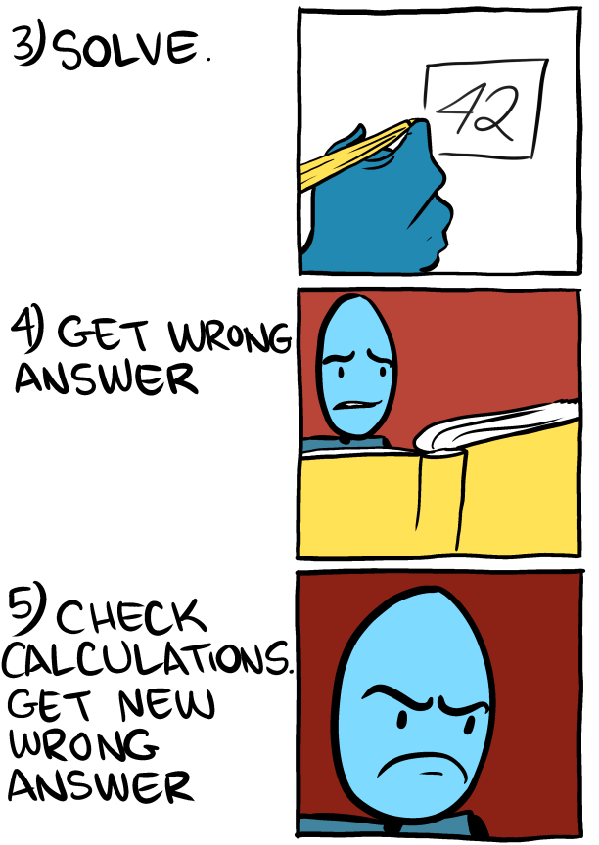
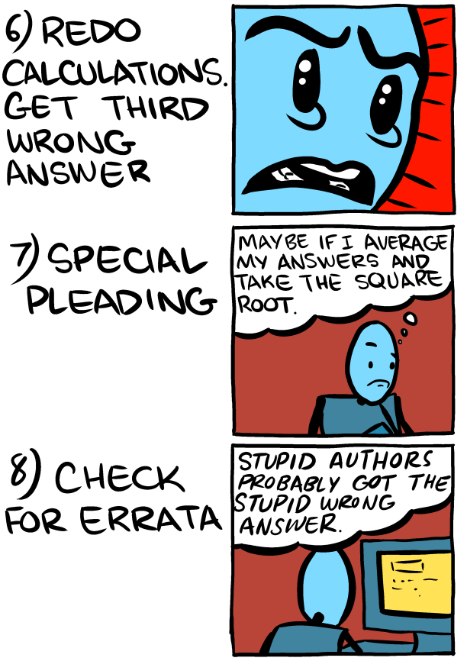
Saturday Morning Breakfast Cereal!
June 16, 2013 (this week!)
Bear with me for a minute. ☺

Slide 6
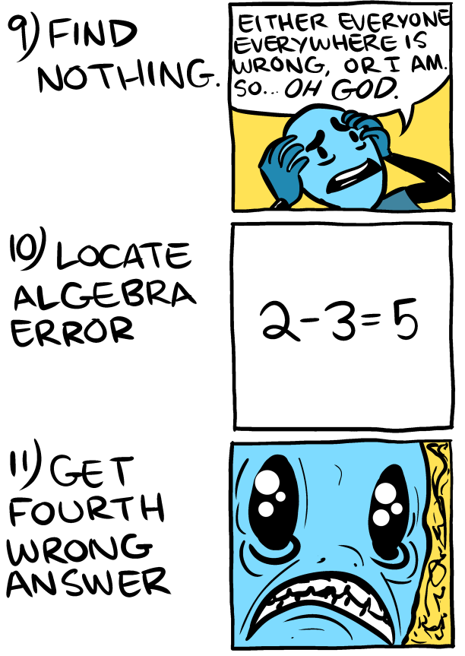
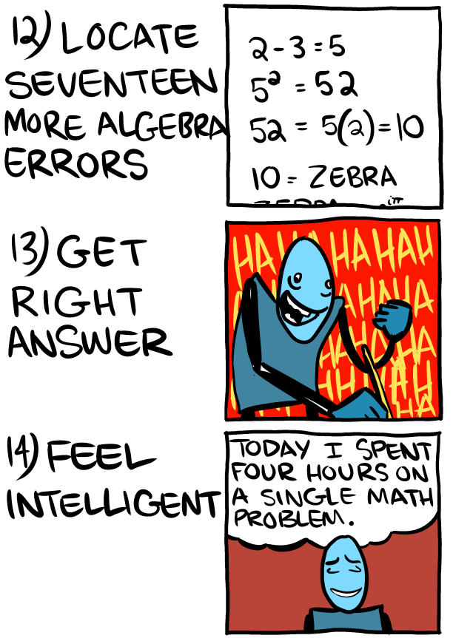
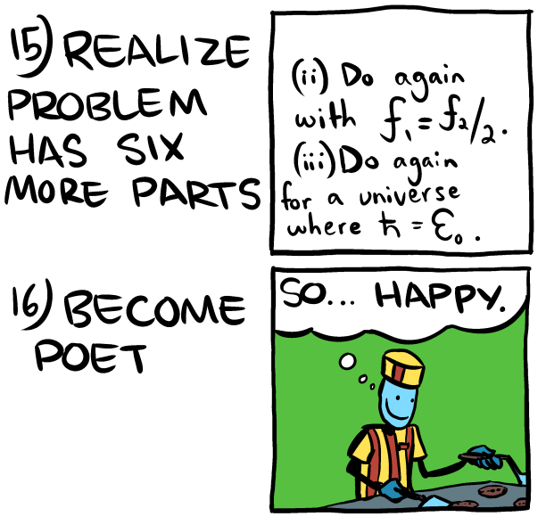
Saturday Morning Breakfast Cereal
Tech Support

Slide 7
What was that all about?
From: http://happybearsoftware.com/you-are-dangerously-bad-at-cryptography.html
"Cryptography is perilous because you get no feedback when you mess up. For the average developer, one block of random base 64 encoded bytes is as good as any other."
"You can get good at programming by accident. If your code doesn't compile, doesn't do what you intended it to or has easily observable bugs, you get immediate feedback, you fix it and you make it better next time."
"You cannot get good at cryptography by accident."

Slide 8
Why am I doing this?
Also from http://happybearsoftware.com/you-are-dangerously-bad-at-cryptography.html
The four stages of competence:
Unconscious incompetence - When you don't know how bad you are or what you don't know.
Conscious incompetence - When you know how bad you are and know what steps you need to take to get better.
Conscious competence - When you're good and you know it (this is fun!)
Unconscious competence - When you're so good you don't know it anymore.
I went to help people go from Unconscious incompetence to Conscious incompetence!

Slide 9
Why am I doing this?
Last plug…
Oddly enough, this is written as a screenplay: "If You're Typing The Letters A-E-S Into Your Code, You're Doing It Wrong"
http://www.cs.berkeley.edu/~daw/teaching/cs261-f12/misc/if.html
Hey look, it's Berkeley!
Same information, same conclusion, as this talk!
A fun, interesting read! One of my first forays into crypto.

Slide 10

History of crypto
The somewhat accurate

Slide 11
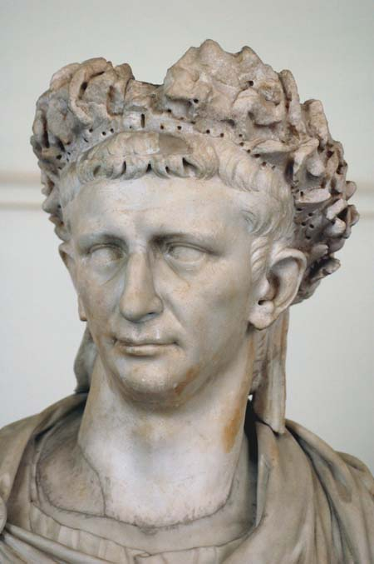
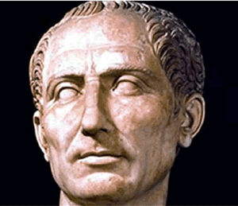
c. 75 BC: Caesar cipher
Shift cipher
25 possible encodings (26, if you count ‘0’)
Trivially bruteforced
J uijol nz gsjfoet bsf uszjoh up ljmm nf!
mpm

Slide 12
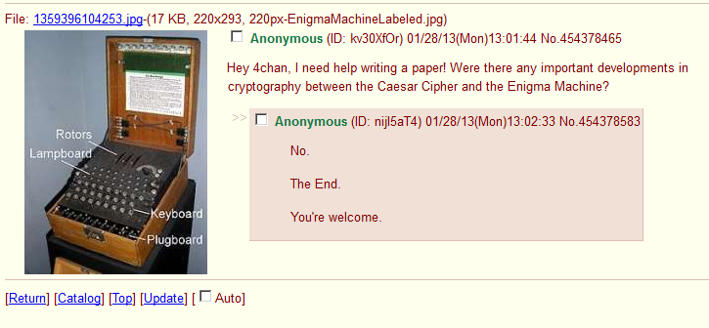
Caesar – World War II: No developments

Slide 13



World War II: Enigma Machine
Notes:
Important to talk about: Cribs – large indexes of what each person typically said
Chit-chat in the clear from Enigma operators
‘continuations’ and times
Turned agent – Treasure – sent long messages that were enciphered in both Dockyard Cipher and Enigma – handy
Initially broken because first three characters and next three characters were encrypted the same way
“Gardening” – planting cribs during important events, eg, planting mines in a carefully chosen position such that the message about them would contain a needed word
No letter would ever decrypt to itself
The same rotor wheel couldn’t be used in adjacent positions
Every German operative in Britain was either captured or turned

Slide 14
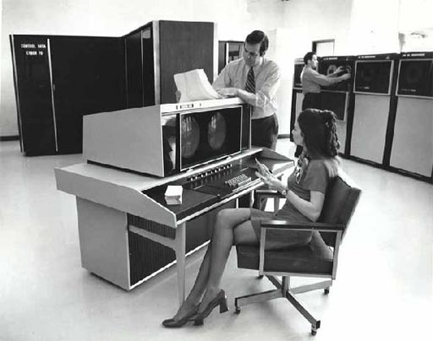
Let’s get more modern

Slide 15



1970s: DES was invented!
A symmetric-key block cipher
Message could be decrypted by the intended recipient and everybody who’s stolen the key
E(“This cereal sucks”)
“Alice”
“Bob”
“Eve” (aka, guy who stole the key)

Slide 16
Still 1970s: Along came DH and RSA
Now both parties have to exchange keys with “Eve” (or each other) before they can communicate
K_{alice}
K_{bob}
K_{eve}
K_{eve}
“Alice”
“Eve”
“Bob”

Slide 17
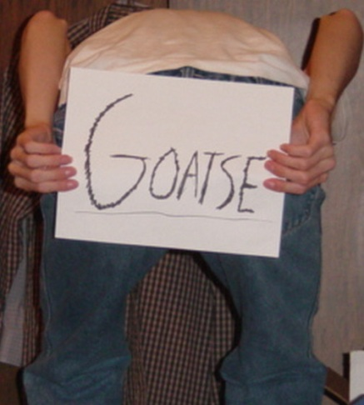
1990s: Certification Authorities
Now you can see if any of 100s of companies thinks the “Bob” is actually “Bob”
K_{eve}
Is this K_{bob}?
Sure, whatever
“Eve”
“Alice”
?
“Bob”

Slide 18

1990s: WEP
While we’re talking about Goatse…
RC4 w/ 24-bit IV
Using RC4 all kinds of wrong led to total compromise

Slide 19
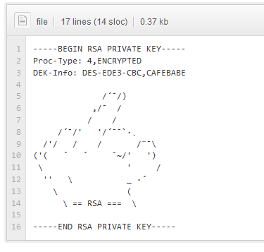
2008: github (and other “Web 2.0” stuff)
A new place for people to post private keys, passwords, and other confidential data

Slide 20
Point?
These days, encryption is rarely broken directly
It’s broken by…
Implementation error (developer mistakes)
Operator error (end-user mistakes)
Document, key, codebook theft/leakage
Stupidity (aka, CAs)
Side-channel attacks
The rest of this talk will be about indirect ways to break state-of-the-art crypto!

Slide 21

Important concepts

Slide 22
Encryption
The act of obscuring data using a secret key, such that only the intended recipient – and anybody else who manages to steal the key – can read it

Slide 23
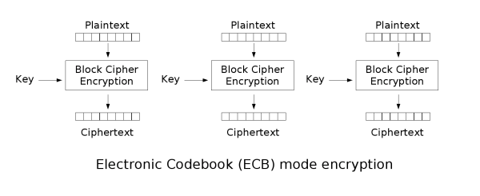
Encryption: Block cipher
Plaintext is broken into 8- or 16-byte blocks, each is encrypted individually
Various “modes of operation” can be used to ensure that the ciphertext is unique

Slide 24

Encryption: Block cipher modes of operation – ECB
“Electronic codebook” mode encrypts each block individually:
This leads to problems like the famous “ECB Tux” image:

Slide 25
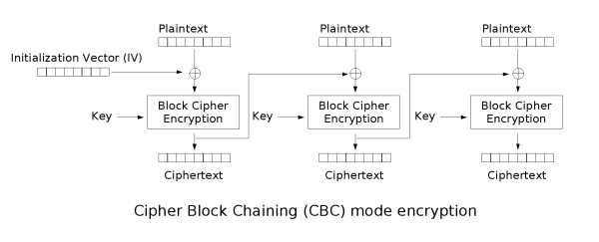
Encryption: Block cipher modes of operation – CBC
“Cipherblock Chaining” feeds the output from each block into the input of the next:
This is much better than CBC, but also has some serious problems
We’ll talk about this in detail when we talk about padding oracles

Slide 26
Initialization vectors: IVs
The ‘input’ into an encryption function
Designed so that the same data encrypted with the same key doesn’t generate the same ciphertext
We’ll see why that’s a problem

Slide 27
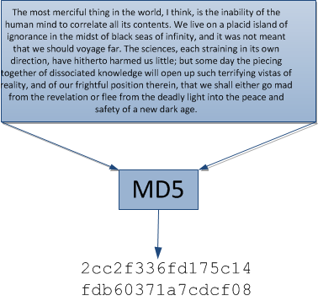
Hashing
Reducing a large amount of data to a small amount
Works similarly to a block cipher, as we’ll see

Slide 28

Attacks
Now, what you all came here for…

Slide 29
Key re-use in block ciphers

Slide 30
Key re-use in block ciphers
Using the same key/IV to encrypt two messages = fail
This affects:
DES (all modes)
3DES (all modes)
AES (all modes)
RC2
RC4
RC5
And… well, everything else I’ve tested, and everything I haven't tested, too… it breaks the entire paradigm

Slide 31
Key re-use in block ciphers: When does this work?
This attack works if:
Any normal cipher is used (block or stream)
Note that there are better ways to attack stream ciphers
The attacker controls at least [blocksize] bytes of the plaintext, preferably at the beginning
Note that only bytes after the attacker-controlled text can be decrypted
The same key and IV are used each time the encryption happens
Note that some ciphers – like ECB – don’t have IVs, so this attack can't really be prevented

Slide 32
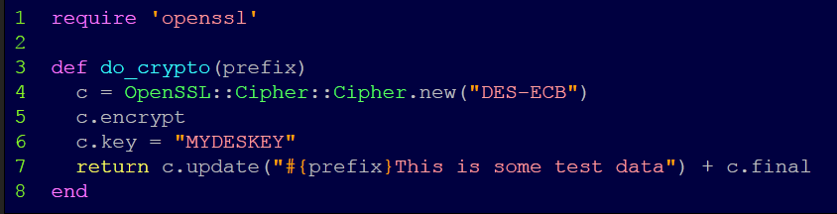
Key re-use in block ciphers – the setup
Here’s our “oracle”:
Note that we’re using “DES-ECB” – this attack will work, as-is, with every block and stream cipher in almost every “mode”
ECB is somewhat special because it can’t be fixed
We’ll talk about ECB, CBC, etc. when we talk about padding oracles

Slide 33
Key re-use in block ciphers: example [1]
Here’s the output from do_crypto(“A” * 16):
P₁ | 'A' | 'A' | 'A' | 'A' | 'A' | 'A' | 'A' | 'A'
C₁ | \x74 | \x31 | \xe1 | \xf0 | \xc6 | \x1b | \x35 | \x11
P₂ | 'A' | 'A' | 'A' | 'A' | 'A' | 'A' | 'A' | 'A'
C₂ | \x74 | \x31 | \xe1 | \xf0 | \xc6 | \x1b | \x35 | \x11
P₃ | 'T' | 'h' | 'i' | 's' | ' ' | 'i' | 's' | ' '
C₃ | \x35 | \x13 | \x7b | \x27 | \xb6 | \xf5 | \xda | \x9c
P₄ | 's' | 'o' | 'm' | 'e' | ' ' | 't' | 'e' | 's'
C₄ | \xb1 | \x0e | \xdf | \x42 | \x93 | \xe8 | \x17 | \x42
P₅ | 't' | ' ' | 'd' | 'a' | 't' | 'a' | \x02 | \x02
C₅ | \xe0 | \x6f | \xcf | \xc0 | \xcf | \xfe | \x87 | \x66
Two blocks of just “A”s (note that the ciphertext is the same)
The rest of the string encrypted as-is

Slide 34
Key re-use in block ciphers: example [2]
Here’s the output from do_crypto(“A” * 7):
P₁ | 'A' | 'A' | 'A' | 'A' | 'A' | 'A' | 'A' | 'T'
C₁ | \xea | \xca | \x59 | \x30 | \x3d | \x8b | \xe6 | \x0f
P₂ | 'h' | 'i' | 's' | ' ' | 'i' | 's' | ' ' | 's'
C₂ | \xf2 | \xaa | \xb1 | \xfb | \x54 | \xb4 | \xb5 | \x87
P₃ | 'o' | 'm' | 'e' | ' ' | 't' | 'e' | 's' | 't'
C₃ | \x34 | \x87 | \x06 | \x80 | \x9a | \xcc | \xad | \x43
P₄ | ' ' | 'd' | 'a' | 't' | 'a' | \x03 | \x03 | \x03
C₄ | \xd3 | \x71 | \x2a | \xf5 | \x79 | \x10 | \x25 | \xea
P₁ | 'A' | 'A' | 'A' | 'A' | 'A' | 'A' | 'A' | 'T'
C₁ | \xea | \xca | \x59 | \x30 | \x3d | \x8b | \xe6 | \x0f
← GOAL
Stuff
That
We
Don’t
Care
About
…
…
…
…

Slide 35
Key re-use in block ciphers: example [3]
Goal:
P₁ | 'A' | 'A' | 'A' | 'A' | 'A' | 'A' | 'A' | 'T'
C₁ | \xea | \xca | \x59 | \x30 | \x3d | \x8b | \xe6 | \x0f
← We’re trying to find a match for this
Note: I’m only showing the first block or two
It’s pretty trivial to guess a single byte…
[‘A’..’Z’ + ‘a’..’z’] do |c| do_crypto(‘AAAAAAA’ + c); end
P₁ | 'A' | 'A' | 'A' | 'A' | 'A' | 'A' | 'A' | 'S'
C₁ | \x1c | \x32 | \x22 | \x39 | \xb7 | \x99 | \x73 | \x42
P₂ | 'T' | 'h' | 'i' | 's' | ' ' | 'i' | 's' | ' '
C₂ | \x35 | \x13 | \x7b | \x27 | \xb6 | \xf5 | \xda | \x9c
← Nope
P₁ | 'A' | 'A' | 'A' | 'A' | 'A' | 'A' | 'A' | 'T'
C₁ | \xea | \xca | \x59 | \x30 | \x3d | \x8b | \xe6 | \x0f
← Oh hai!
P₁ | 'A' | 'A' | 'A' | 'A' | 'A' | 'A' | 'A' | 'U'
C₁ | \x5a | \x3c | \x17 | \x25 | \xc8 | \x0f | \x68 | \x3f
← Nope

Slide 36
Key re-use in block ciphers: example [4]
Here’s the output from do_crypto(“A” * 6):
P₁ | 'A' | 'A' | 'A' | 'A' | 'A' | 'A' | 'T' | 'h'
C₁ | \xcb | \x7a | \x74 | \xd0 | \x38 | \x45 | \xbf | \x21
P₂ | 'i' | 's' | ' ' | 'i' | 's' | ' ' | 's' | 'o'
C₂ | \xf9 | \x8e | \xcd | \xdf | \x49 | \xf0 | \x86 | \xcb
P₃ | 'm' | 'e' | ' ' | 't' | 'e' | 's' | 't' | ' '
C₃ | \x70 | \x8c | \xc0 | \x1d | \xe5 | \xf2 | \xdc | \x01
P₄ | 'd' | 'a' | 't' | 'a' | \x04 | \x04 | \x04 | \x04
C₄ | \xb4 | \x74 | \xfc | \x99 | \xd9 | \xbe | \xd2 | \x70
P₁ | 'A' | 'A' | 'A' | 'A' | 'A' | 'A' | 'T' | 'h'
C₁ | \xcb | \x7a | \x74 | \xd0 | \x38 | \x45 | \xbf | \x21
← GOAL
Stuff
That
We
Don’t
Care
About
…
…
…
…

Slide 37
Key re-use in block ciphers: example [5]
P₁ | 'A' | 'A' | 'A' | 'A' | 'A' | 'A' | 'T' | 'h'
C₁ | \xcb | \x7a | \x74 | \xd0 | \x38 | \x45 | \xbf | \x21
← We’re trying to find a match for this
Once again, we’re guessing a single byte:
[‘A’..’Z’ + ‘a’..’z’] do |c| do_crypto(‘AAAAAAT’ + c); end
Note: I’m only showing the first block or two
P₁ | 'A' | 'A' | 'A' | 'A' | 'A' | 'A' | 'T' | 'g'
C₁ | \xbb | \x48 | \x96 | \xa3 | \xb9 | \xb5 | \xc4 | \x32
P₂ | 'T' | 'h' | 'i' | 's' | ' ' | 'i' | 's' | ' '
C₂ | \x35 | \x13 | \x7b | \x27 | \xb6 | \xf5 | \xda | \x9c
← Nope
P₁ | 'A' | 'A' | 'A' | 'A' | 'A' | 'A' | 'T' | 'h'
C₁ | \xcb | \x7a | \x74 | \xd0 | \x38 | \x45 | \xbf | \x21
← Oh hai!
P₁ | 'A' | 'A' | 'A' | 'A' | 'A' | 'A' | 'T' | 'i'
C₁ | \x79 | \xc2 | \x04 | \x11 | \x64 | \xd0 | \xae | \xc2
← Nope

Slide 38
Key re-use in block ciphers: What’s going on?
We continue likewise till we’ve decrypted the entire packet
What’s going on?
We’re forcing the first unknown byte to be on a block boundary, then guessing it
We can guess any character in 256 guesses, as long as we know all the characters before it

Slide 39

Key re-use in block ciphers: A tool!
I wrote a tool called “Prephixer” to implement this attack
https://www.github.com/iagox86/prephixer
Let’s do a demo!

Slide 40
Preventing key re-use in block ciphers
Use different initialization vectors (IVs) when encrypting data (they don't even have to be good! Just different!)
If possible, use a different key (not always possible or even preferable)
If you’re using ECB mode…. WHY ARE YOU USING ECB MODE!?

Slide 41
Hash length extension attacks

Slide 42
Hash length extension attacks
This is why I became interested in crypto attacks
It was used in Stripe CTF
The basic idea: most hash algorithms (not SHA3) can “pick up where they left off”
All hash algorithms that use Merkle–Damgård chaining are "vulnerable", SHA3 doesn't
What’s that mean for security?
Let’s find out!

Slide 43
Hash length extension: the setup
This is an attack where the following happens:
Server calculates the following value:
Then sends that verifier and data to the user
Later, when the user sends the data back, the server uses the verifier to ensure the data hasn't changed
The “Bad” operations are in red
verifier = H(secret || data)
if(H(secret || new_data) != verifer)
throw error()
else
trusted_operation(attacker_data)

Slide 44
How hashing works…
Let's look at an example…
SHA1("The most merciful thing in the world, I think, is the inability of the human mind to correlate all its contents. We live on a placid island of ignorance in the midst of black seas of infinity, and it was not meant that we should voyage far. The sciences, each straining in its own direction, have hitherto harmed us little; but some day the piecing together of dissociated knowledge will open up such terrifying vistas of reality, and of our frightful position therein, that we shall either go mad from the revelation or flee from the deadly light into the peace and safety of a new dark age.")
First, the string is broken into 64-character blocks (for SHA1):
"The most merciful thing in the world, I think, is the inability " "of the human mind to correlate all its contents. We live on a pl" "acid island of ignorance in the midst of black seas of infinity," " and it was not meant that we should voyage far. The sciences, e" "ach straining in its own direction, have hitherto harmed us litt" "le; but some day the piecing together of dissociated knowledge w" "ill open up such terrifying vistas of reality, and of our fright" "ful position therein, that we shall either go mad from the revel" "ation or flee from the deadly light into the peace and safety of" " a new dark age."

Slide 45
How hashing works
Padding is added to the last block:
The padding is equal to a 1-bit followed by a bunch of zero bits (“\x80\0\0\0\0.…”) followed by the length in bits
The last eight bytes are equal to the length of the string (0x250 bytes) in bits (0x1280 bits)
"The most merciful thing in the world, I think, is the inability " "of the human mind to correlate all its contents. We live on a pl" "acid island of ignorance in the midst of black seas of infinity," " and it was not meant that we should voyage far. The sciences, e" "ach straining in its own direction, have hitherto harmed us litt" "le; but some day the piecing together of dissociated knowledge w" "ill open up such terrifying vistas of reality, and of our fright" "ful position therein, that we shall either go mad from the revel" "ation or flee from the deadly light into the peace and safety of" " a new dark age.\x80\0\0\0\0\0\0\0\0\0\0\0\0..........\0\x12\x80"

Slide 46
How hashing works
Each block is hashed individually, and its output is fed into the next block
"The most merciful thing in the world, I think, is the inability "
3be731c7 5880ab49 5d90c0cd df295189 b3c91449
"of the human mind to correlate all its contents. We live on a pl"
58ec922f bdee6eec 699db098 a378f875 2b29d697
"acid island of ignorance in the midst of black seas of infinity,"
c55bc6a3 b26d5dd0 96166093 5d73c256 7f357a83
"ation or flee from the deadly light into the peace and safety of"
845b75f7 403a1814 30ee1c70 8a229eab c88c00d9
" a new dark age.\x80\0\0\0\0\0\0\0\0\0\0\0\0..........\0\x12\x80"
ed8873c1 07d882b7 b6fcbbc1 9a272d61 4cf9e7ee
The output of the last block is our hash
In other words, the final hash is made up of the entire state!

Slide 47

Hash extension: We’re almost there!
What if we add another block, after the padding?
What good is that?
Because 100% of the state was included in the final hash – ed8873c1 07d882b7 b6fcbbc1 9a272d61 4cf9e7ee – we could add more data to the plaintext and calculate a new hash without knowing the plaintext!
"ation or flee from the deadly light into the peace and safety of"
845b75f7 403a1814 30ee1c70 8a229eab c88c00d9
" a new dark age.\x80\0\0\0\0\0\0\0\0\0\0\0\0..........\0\x12\x80"
ed8873c1 07d882b7 b6fcbbc1 9a272d61 4cf9e7ee
"Hello? Yes, this is dog." (+ implicit padding)
37a780c2 e1f8a3e9 f99a7561 f12c9945 f0d82b12

Slide 48
Hash extension: And here we are!
Let's say that again, to make sure we're clear: we just calculated the checksum for:
(original_text || padding || "Hello? Yes, this is dog.")
Knowing only:
The output of the original hash function:
ed8873c1 07d882b7 b6fcbbc1 9a272d61 4cf9e7ee
And the text we wanted to add:
"Hello? Yes, this is dog."
We did not need to know original_text!
“||” is the “concatenate” operator in crypto. @mak_kolybabi yells at me if I don’t use it.

Slide 49

Hash extension: Applying it
Flickr used to have an API something like this:
message = SHA1(shared_secret || commands) + commands
Where shared_secret = the user's key (aka, a password)
Example:
message = SHA1("secretkey" + "name=ron") + "name=ron"
message = "\x0e\x78\x45\x47\x5d\xbe\x78\x41\x54\xe1\x55" + "\x36\x5d\xff\xf4\xe5\x4b\x15\x66\xa8name=ron"
“Flickr”
“Ron”
“\x0e\x78\x45\x47\x5d\xbe\x78\x41\x54\xe1\x55\x36\x5d\xff\xf4\xe5\x4b\x15\x66\xa8name=ron”
Intercepted!
Using…
WIRESHARK!
“Eve”

Slide 50
Hash extension: Applying it
Now, Eve has a message and its associated hash. What can he use it for?
Remember, because of padding, this is what's actually hashed:
But wait… as we saw before, this is the entire state of the hash! So why can't we add another block?
Answer: We can!
"secretkeyname=ron\x80\0\0\0\0\0\0\0\0\0\0...\0\0\0\0\0\x88"
0e784547 5dbe7841 54e15536 5dfff4e5 4b1566a8

Slide 51
Hash extension: Applying it
Let’s look at how both the evil client and the legit server calculates that hash:
"secretkeyname=ron\x80\0\0\0\0\0\0\0\0\0\0...\0\0\0\0\0\x88"
0e784547 5dbe7841 54e15536 5dfff4e5 4b1566a8
"&deletemyaccount=1" (+ implicit padding)
d281ac3c f91dbb96 0ec12c4e 0e5d73bd 91be6f10
We don't need to know the original data!

Slide 52
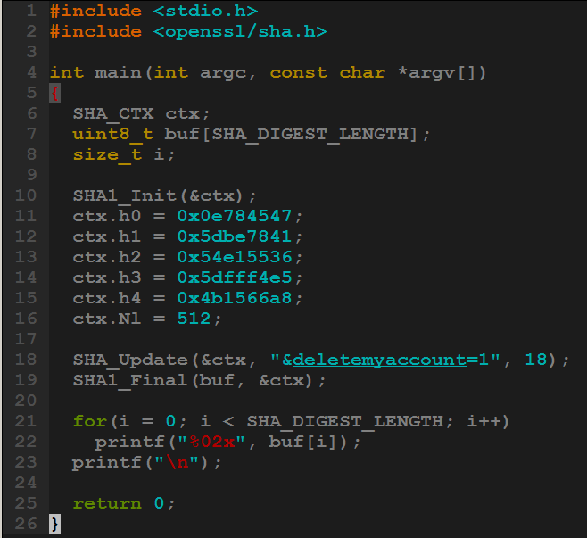
Hash extension: evil client
← Eve writes this program
Looks right!
$ gcc -o test test.c -lssl -lcrypto
$ ./test
d281ac3cf91dbb960ec12c4e0e5d73bd91be6f10

Slide 53
Hash extension: Evil client -> legit server
Eve then sends the following to the server:
\xd2\x81\xac\x3c\xf9\x1d\xbb\x96\x0e\xc1\x2c\x4e\x0e\x5d\x73\xbd\x91\xbe\x6f\x10name=ron\x80\x00\x00\x00\x00\x00\x00\x00\x00\x00\x00\x00\x00\x00\x00\x00\x00\x00\x00\x00\x00\x00\x00\x00\x00\x00\x00\x00\x00\x00\x00\x00\x00\x00\x00\x00\x00\x00\x00\x00\x00\x00\x00\x00\x00\x00\x88&deletemyaccount=1 [...implicit padding...]
New signature
Original text
Original padding
New (appended) data
Implicit padding will be added

Slide 54
Hash extension: Legit server
The legit server prepends the secret key to the data Eve sent, and calculates the hash:
1.9.3p194 :002 > require 'openssl'
=> true
1.9.3p194 :004 > Digest::SHA1.hexdigest("secretkey" + "name= ron\x80\x00\x00\x00\x00\x00\x00\x00\x00\x00\x00\x00\x00\x00\x00\x00\x00\x00\x00\x00\x00\x00\x00\x00\x00\x00\x00\x00\x00\x00\x00\x00\x00\x00\x00\x00\x00\x00\x00\x00\x00\x00\x00\x00\x00\x00\x88&deletemyaccount=1")
=> "d281ac3cf91dbb960ec12c4e0e5d73bd91be6f10"
Remember what Eve calculated!
$ gcc -o test test.c -lssl -lcrypto
$ ./test
d281ac3cf91dbb960ec12c4e0e5d73bd91be6f10

Slide 55
Hash extension: A tool!
It’s amazingly difficult to write these attacks by hand
I never fail to mess up the number of zeroes, or forget to convert the length to bits, or screw up endianness
Luckily, you don’t have to! I wrote hash_extender to take care of that
hash_extender supports the following hashes:
MD4, MD5, RIPEMD160, SHA, SHA1, SHA256, SHA512, Whirlpool
The following hash types are more difficult to extend, because the state is truncated before being used:
SHA224, SHA384
And, the following hash type is impossible to extend, by design, although time will tell:
SHA3

Slide 56
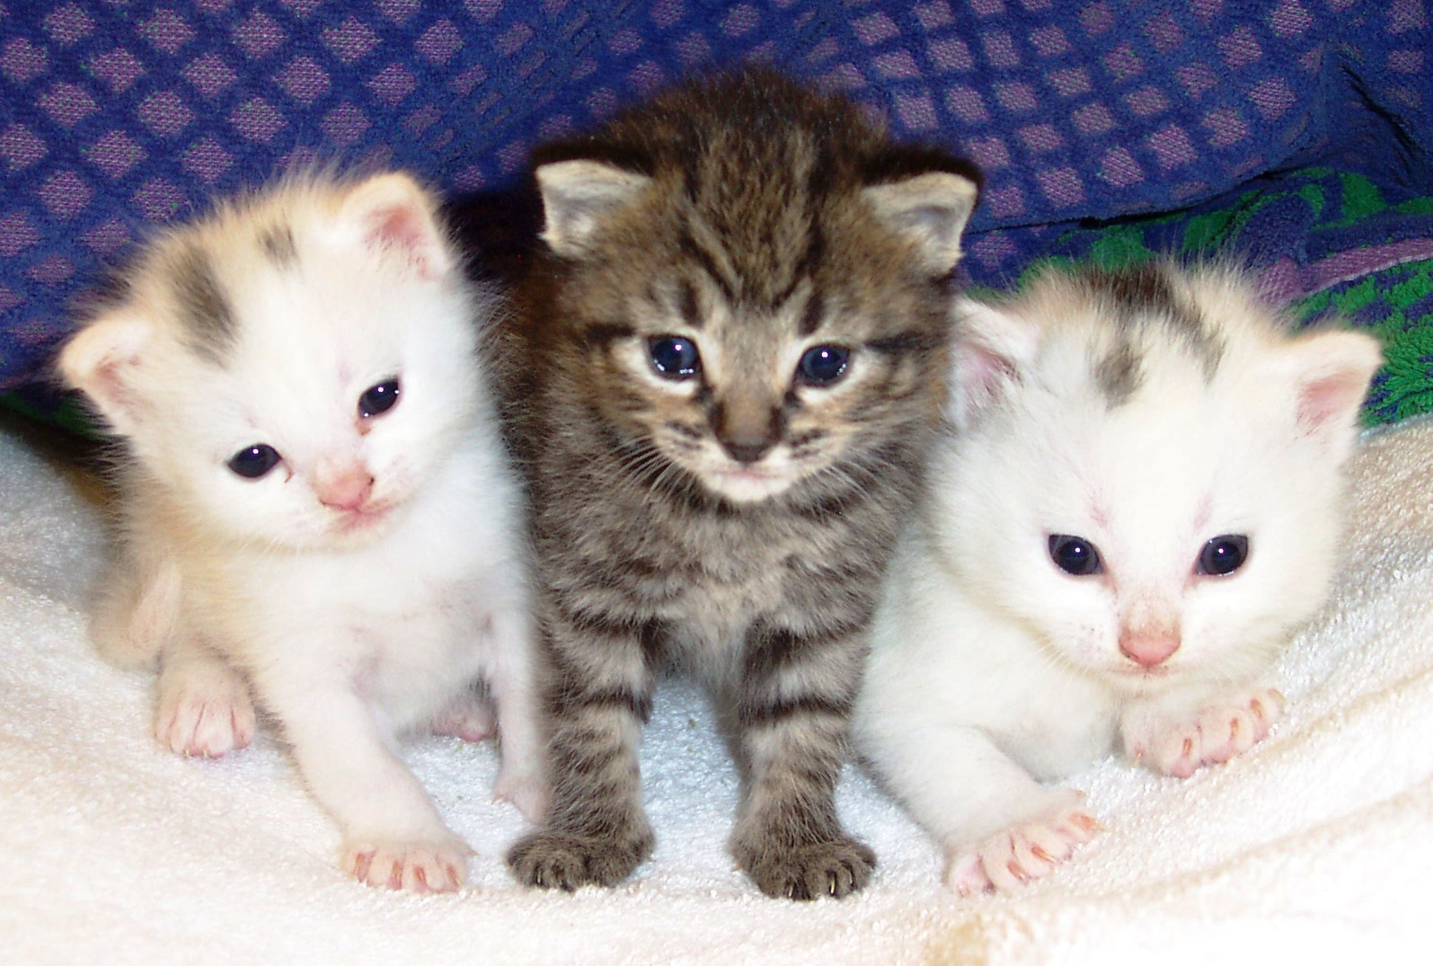
That was a lot of material…
So let’s look at some kittens then do a demo

Slide 57
Hash extension: summary
If an attacker has access to a hash in the form of:
H(secret + “knowndata”)
He can trivially calculate:
H(secret + “knowndata” + padding + anything)

Slide 58
Hash extension: Defense
HMAC.
Next topic.
(Actually, any authenticated hashing algorithm will work – the point is, don't use hashes for this type of validation)

Slide 59

Padding oracles

Slide 60
Padding oracles
Hash extension attacks are fairly simple to understand – you just have to realize that hashes can “pick up where they left off”
Padding oracles, on the other hand, require a bit more of a leap
That being said, let’s do it!

Slide 61
Padding oracles: Overview
Not to be confused with the Oracle database…
This isn’t an attack against any particular algorithm, but against cipher-block chaining (CBC)
Invented (discovered?) by Serge Vaudenay in the early 2000s, also called the “Vaudenay attack”
A padding oracle attack occurs when an attacker has encrypted and unknown data that he can ask a server to secretly decrypt
The data is a block cipher (DES, AES, etc) in CBC mode
The server doesn’t give indication as to what the plaintext data is
The server returns a boolean value indicating whether the decryption succeeded (which is based on the padding)

Slide 62
Padding oracles: Padding
We already talked about padding on hashes, but this is different
Block ciphers require the data to be padded such that it’s a multiple of the blocksize
If the data is already a multiple, an empty block is added
It doesn’t matter what the padding is, just that it's known and unambiguous
Let’s look at the most common…

Slide 63
Padding oracles: Padding
Typically, PKCS #7 is used, which says…
The value of the padding = the number of bytes of padding
Eg (assume block size = 8 [DES, for example]):
H | e | l | l | o | \x03 | \x03 | \x03
H | e | l | l | o |  | W | o | r | l | d | \x05 | \x05 | \x05 | \x05 | \x05
P | a | s | s | w | o | r | d | \x08 | \x08 | \x08 | \x08 | \x08 | \x08 | \x08 | \x08
Block 1
Block 2

Slide 64
Padding oracles: CBC mode encryption
Now that we’ve looked at padding, let’s look at how the blocks fit together
We already talked about electronic codebook (ECB) and cipher-block chaining (CBC)
The “padding oracle attack” is actually an attack against CBC
Let’s see why…

Slide 65
Padding oracles: CBC mode encryption
For any given block of plaintext, P_{n}, the corresponding ciphertext, C_{n}, can be calculated as:
In other words, you XOR the plaintext with the previous ciphertext, then encrypt it
C_{n} = E(P_{n} ⊕ C_{n-1})

Slide 66
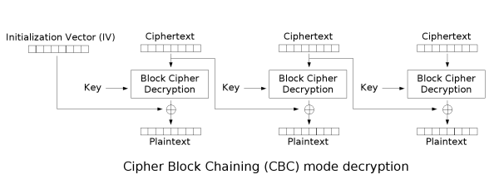
Padding oracles: CBC mode decryption
For any given block of ciphertext, C_{n}, we can calculate the corresponding plaintext, P_{n}, as:
In other words, the ciphertext is decrypted, then XORed with the previous ciphertext
P_{n} = D(C_{n}) ⊕ C_{n-1}

Slide 67
Padding oracles
So, we have two formulas:
We can verify these make sense by encrypting and decrypting a block:
C_{n} = E(P_{n} ⊕ C_{n-1})
P_{n} = D(C_{n}) ⊕ C_{n-1}
P_{n} = D(E(P_{n} ⊕ C_{n-1})) ⊕ C_{n-1}
P_{n} = P_{n} ⊕ C_{n-1} ⊕ C_{n-1}
P_{n} = P_{n}
Decrypt the encrypted data
Two XORs cancel out
Hint: what happens if they don't?
Success!

Slide 68
Padding oracles
Encryption steps…
Plaintext (P)
Decrypted (P')
This is the dangerous part
Add padding
Remove/verify padding
Encrypt each block
Decrypt each block
Send
Receive
Sender
Receiver

Slide 69
Padding oracles
Let's start with how this is "supposed" to work
Example string: "Hello World"
P = "Hello World"
Plaintext (P)
Decrypted (P')
Add padding
Remove/verify padding
Encrypt each block
Decrypt each block
Send
Receive
Sender
Receiver

Slide 70
Padding oracles
Adding padding
"Hello World" is 11 characters
With a blocksize of 8, that means we have one full block ("Hello Wo"), and one block of 3 characters ("rld")
Therefore, we need 5 bytes of padding
Plaintext (P)
Decrypted (P')
P = “Hello World”
Add padding
Remove/verify padding
P₁ = “Hello Wo”
P₂ = “rld”
Encrypt each block
Decrypt each block
P₁ = “Hello Wo”
P₂ = “rld\5\5\5\5\5”
Send
Receive
Sender
Receiver

Slide 71
Padding oracles
P₁ is encrypted to become C₁
P₂ is encrypted, then XORed with C₁, to become C₂.
C₁ and C₂ are combined to make C.
P₁ = “Hello Wo”
P₂ = “rld\5\5\5\5\5”
Plaintext (P)
Decrypted (P')
⊕
Add padding
Remove/verify padding
C₁ = “8aec483e43027f22”
C₂ = “287ca837fb65e219”
Encrypt each block
Decrypt each block
C = “8aec483e43027f22""287ca837fb65e219”
Send
Receive
Sender
Receiver

Slide 72
Padding oracles
The ciphertext – C – is transmitted to the (possibly malicious) user
It's important to remember that while the user can store it and send it back to the server, the user cannot decrypt it
Plaintext (P)
Decrypted (P')
C = “8aec483e43027f22""287ca837fb65e219”
Add padding
Remove/verify padding
Encrypt each block
Decrypt each block
Send
Receive
Sender
Receiver

Slide 73
Padding oracles
At some point in the future, the user will return the encrypted data to the server
This is where the attack and normal usage diverge, as we'll see
Plaintext (P)
Decrypted (P')
Add padding
Remove/verify padding
Encrypt each block
Decrypt each block
Send
Receive
C' = “8aec483e43027f22""287ca837fb65e219”
Sender
Receiver

Slide 74
Padding oracles
The server breaks C' back into C'₁ and C'₂
C'₁ is decrypted into P'₁
C'₂ is decrypted then XORed with C'₁ to become P'₂
Note: the server, at this point, doesn't know if valid data was produced
Plaintext (P)
Decrypted (P')
C' = “8aec483e43027f22""287ca837fb65e219”
Add padding
Remove/verify padding
C'₁ = “8aec483e43027f22”
C'₂ = “287ca837fb65e219”
Encrypt each block
Decrypt each block
⊕
P'₁ = “Hello Wo”
P'₂ = “rld\5\5\5\5\5”
Send
Receive
Sender
Receiver

Slide 75
Padding oracles
The server looks at the last byte of the last block – "\5" – and verifies that the last 5 bytes are all equal to "\5" – otherwise, the padding is wrong
Once padding is verified, it's removed and the blocks are reunited
This is all that's done to verify that the data decrypted properly
Plaintext (P)
Decrypted (P')
Add padding
Remove/verify padding
P'₁ = “Hello Wo”
P'₂ = “rld\5\5\5\5\5”
Encrypt each block
Decrypt each block
Send
Receive
P' = “Hello World”
Sender
Receiver

Slide 76
Padding oracles
And now, we're back where we started
P' = P, as it's supposed to
P' = “Hello World”
Plaintext (P)
Decrypted (P')
Add padding
Remove/verify padding
Encrypt each block
Decrypt each block
Send
Receive
Sender
Receiver

Slide 77
Padding oracles
Now let's look at an example of how we can attack this…

Slide 78
Padding oracles
Here are the first three steps again, same as last time
P = “Hello World”
P₁ = “Hello Wo”
P₂ = “rld”
Plaintext (P)
Decrypted (P')
P₁ = “Hello Wo”
P₂ = “rld\5\5\5\5\5”
⊕
Remove/verify padding
Add padding
C₁ = “8aec483e43027f22”
C₂ = “287ca837fb65e219”
Encrypt each block
Decrypt each block
C = “8aec483e43027f22""287ca837fb65e219”
Send
Receive
Sender
Receiver

Slide 79
Padding oracles
This time, the data is sent to a malicious user, such as Eve
As before, Eve cannot decrypt this. But she wants to, and will find a way!
C = “8aec483e43027f22""287ca837fb65e219”
Plaintext (P)
Decrypted (P')
Add padding
Remove/verify padding
Encrypt each block
Decrypt each block
Send
Receive
Sender
Receiver

Slide 80
Padding oracles
Eve is going to focus only on the second half of the cipher, C₂ (note that this can apply to any block)
She generates a brand new block for C'₁, then prepends it to C₂ to form C'
C'₂ = “287ca837fb65e219”
Plaintext (P)
Decrypted (P')
C'₁ = “0000000000000000”
C'₂ = “287ca837fb65e219”
Add padding
Remove/verify padding
Used all zeroes for convenience – not necessary
Encrypt each block
Decrypt each block
Send
Receive
C' = “0000000000000000""287ca837fb65e219”
Sender
Receiver

Slide 81
Padding oracles
Now, what happens when the server tries to decrypt this new C'?
Remember, C'₂ is XORed with C'₁ after it's decrypted
C' = "0000000000000000287ca837fb65e219"
Plaintext (P)
Decrypted (P')
C'₁ = "0000000000000000"
C'₂ = "287ca837fb65e219"
Remove/verify padding
Add padding
⊕
Encrypt each block
Decrypt each block
P'₁ = [garbage]
P'₂ = [garbage, kinda]
Let's take a closer look at P'₂ …
Reminder: the client sees none of this!
Send
Receive
Sender
Receiver

Slide 82
Padding oracles
Did you notice…
There are no longer any cryptographic operations in our formula?
Recall our decryption formula:
So C'₂ is being decrypted in the usual way, then XORed with C'₁ instead of with the actual C₁!
Instead of undoing the original XOR, it's adding another XOR layer:
P_{n} = D(C_{n}) ⊕ C_{n-1}
P₂ = D(C'₂) ⊕ C'₁
C'₁ = "0000000000000000 "
C'₂ = "287ca837fb65e219"
Plaintext (P)
Decrypted (P')
Add padding
Remove/verify padding
Encrypt each block
Decrypt each block
P'₂ = P₂ ⊕ C₁ ⊕ C'₁
Send
Receive
P'₂ != P₂
Sender
Receiver

Slide 83
Padding oracles
To put it another way…
Original decryption:
New decryption:
_{…can't reduce any further}
P_{n} = D(E(P_{n} ⊕ C_{n-1})) ⊕ C_{n-1}
P_{n} = P_{n} ⊕ C_{n-1} ⊕ C_{n-1}
P_{n} = P_{n}
P_{n} = D(E(P_{n} ⊕ C_{n-1})) ⊕ C'_{n-1}
P_{n} = P_{n} ⊕ C_{n-1} ⊕ C'_{n-1}

Slide 84
Padding oracles
So now we have this formula:
But what's it mean?
The first thing we want to do is re-arrange it, because we want to solve for the original plaintext, P₂ :
This is legal, because
P'₂ = P₂ ⊕ C₁ ⊕ C'₁
Plaintext (P)
Decrypted (P')
Add padding
Remove/verify padding
P₂ = P'₂ ⊕ C₁ ⊕ C'₁
Encrypt each block
Decrypt each block
A ⊕ B = B ⊕ A
Send
Receive
Sender
Receiver

Slide 85
Padding oracles
P₂ = P'₂ ⊕ C₁ ⊕ C'₁
Here's that formula again. And here's what the terms mean:
P₂ = The original plaintext value (our goal)
P’₂ = The value the server calculates (mostly a garbage string)
C₁ = The previous ciphertext block (known to us)
C'₁ = The ciphertext block chosen by the attacker
Plaintext (P)
Decrypted (P')
We control C'₁, and we know C₁, but what about P₂ and P'₂?
We have an equation with two unknowns!
Or do we?
Add padding
Remove/verify padding
Encrypt each block
Decrypt each block
Send
Receive
Sender
Receiver

Slide 86
Padding oracles
P'₂ = P₂ ⊕ C₁ ⊕ C'₁
Let's focus on P'₂, and move on to the next step: Remove/verify padding
If P'₂ decrypts to:
"[garbage]\x00" ← Bad padding
"[garbage]\x01" ← Good padding
"[garbage]\x02" ← Bad padding (probably*)
"[garbage]\x03" ← Bad padding
"[garbage]\x04" ← Bad padding
"[garbage]\x05" ← Bad padding
……
By definition – for this attack – the server tells us when the padding is good or bad
Let's ignore the rare case where the string happens to end with \x02\x02 or \x03\x03\x03 or …
Plaintext (P)
Decrypted (P')
Add padding
Remove/verify padding
Encrypt each block
Decrypt each block
Send
Receive
Sender
Receiver

Slide 87
Padding oracles
P'₂ = P₂ ⊕ C₁ ⊕ C'₁
What's this mean for our attack?
As soon as the padding is correct, we know the last byte of the new plaintext (P'₂)
That's big. That's HUGE!
Suddenly, our equation for the last byte of P₂ only has one unknown!
All we have to do is send 256 values for the last byte of C'₁, and we're eventually going to get valid padding
Plaintext (P)
Decrypted (P')
Add padding
Remove/verify padding
Encrypt each block
Decrypt each block
Send
Receive
Sender
Receiver

Slide 88
Padding oracles
Let’s only focus on the last bytes:
To define everything again…
P₂[n] = The last byte of plaintext (the value we want!)
P'₂[n] = The last byte of what the server ends up decrypting (proper padding = "\x01")
C₁[n] = The last byte of the original first block
C'₁[n] = The last byte of the new first block
We can now calculate P₂[n]!
P₂[n] = 1 ⊕ C₁[n] ⊕ C'₁[n]
P₂[n] = P'₂ [n] ⊕ C₁[n] ⊕ C'₁[n]
Plaintext (P)
Decrypted (P')
Add padding
Remove/verify padding
Encrypt each block
Decrypt each block
Send
Receive
Sender
Receiver

Slide 89
Padding oracles
So, to summarize:
Choose a new block, which we call C', and prepend it to the block you’re trying to decrypt:
Change the last byte of C’ until you stop getting a padding error:
Plug it into the formula, where you know 3 of the values:
And solve!
C' = “0000000000000000”
C₂ = “287ca837fb65e219”
C' = “0000000000000026”
C₂ = “287ca837fb65e219”
P₂[n] = P'₂[n] ⊕ C₁[n] ⊕ C'₁ [n]
P₂[n] = 0x01 ⊕ 0x22 ⊕ 0x26
P₂[N] = 0x05
Recall:
P₂ = “rld\5\5\5\5\5”

Slide 90
Padding oracles
By having the server tell us when the last byte of the decrypt block is right, we can trivially decrypt and encrypt it using only the XOR operation
The last byte can be set to \x02, and the second-last byte can be guessed using the same formula
The last and second-last bytes can be set to \x03\x03, and the third-last byte can be guessed using the same formula
…and so on, until the whole block is decrypted

Slide 91

Introducing: Poracle
Like all these attacks, I wrote a tool
This one’s called “Poracle”

Slide 92
Padding oracles: Prevention
How do you prevent padding oracles?
HMAC!
By prepending an HMAC hash to the encrypted data – and validating it before the decryption is performed – you can check if anybody has tampered with the hash!
You can also prevent this by using a block cipher mode of operation other than cipher-block chaining – eg, counter mode, output feedback, plaintext feedback, etc.

Slide 93

Almost there!

Slide 94


Solutions
Because people get mad at me for just pointing out problems…

Slide 95
Solution #1: don’t give attackers encrypted data
This isn’t always possible
When you can, give an index, a session, or something like that, rather than letting an attacker store state

Slide 96

Or, to put it another way…

Slide 97
Solution #2: When you give them encrypted data, validate it
“The cryptographic doom principle”
Calculate a HMAC and send it with the encrypted data
Validate the HMAC before attempting to decrypt
Alternatively, use authenticated encryption, for example, "GCM Mode"
Coming soon: CAESAR
CAESAR: Competition for Authenticated Encryption: Security, Applicability, and Robustness

Slide 98

“The cryptographic doom principle”

Slide 99

Solution #3: Never encrypt data with the same key and IV
Almost every cipher fails if you use the same key and IV
Change keys when it makes sense, and change IVs every time

Slide 100
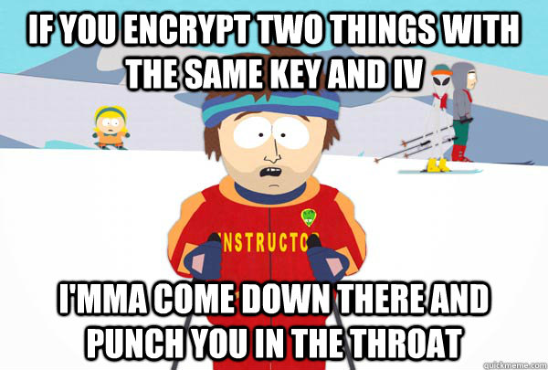
One last ski instructor, then we’re done!

Slide 101
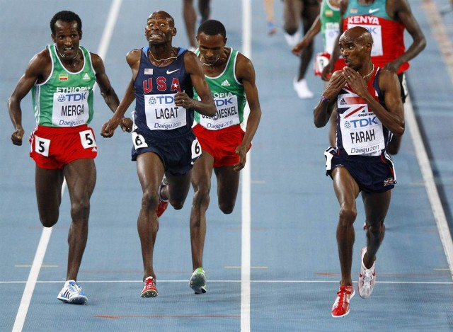
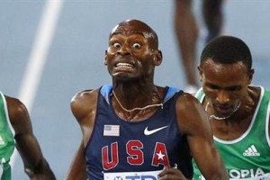
That’s all!

Slide 102
Did you enjoy that?
Go see Alex Weber's talk, Wednesday @ 2pm for a look at some other side channel attacks!

Slide 103
Links + Contact info
Me:
Ron Bowes <ron.bowes@leviathansecurity.com>
@iagox86
http://www.skullsecurity.org
http://www.leviathansecurity.com
Tools:
https://www.github.com/iagox86/prephixer
https://www.github.com/iagox86/poracle
https://www.github.com/iagox86/hash_extender
https://www.github.com/iagox86/unzipher
This talk will be on https://www.github.com/iagox86 as well
I think Sharkfest will be posting the slides and a recording, so keep your eyes out!

